Slide 1
Quality assessment of register based Statistics
Manuela Lenk
Statistics Austria
Head of Department Registers, Classifications and Geoinformation
August 20-24, 2018
Workshop on Survey Statistics 2018

Slide 2

Evolution of the Austrian Census
2001 Last traditional census High burden for respondents, considerable financial effort (72 million Euros)
2006 Register-based test census Methods, data procedures and use of registers were successfully tested
2009 Start of annual register-based labour market statistics Possibility for application and improvement of methods
2011 First complete register-based census No burden for respondents, costs reduced to 10 million Euros –
Data from 8 base and 7 comparison registers (50 data holders)
since 2012 Annual register-based labour market statistics

Slide 3
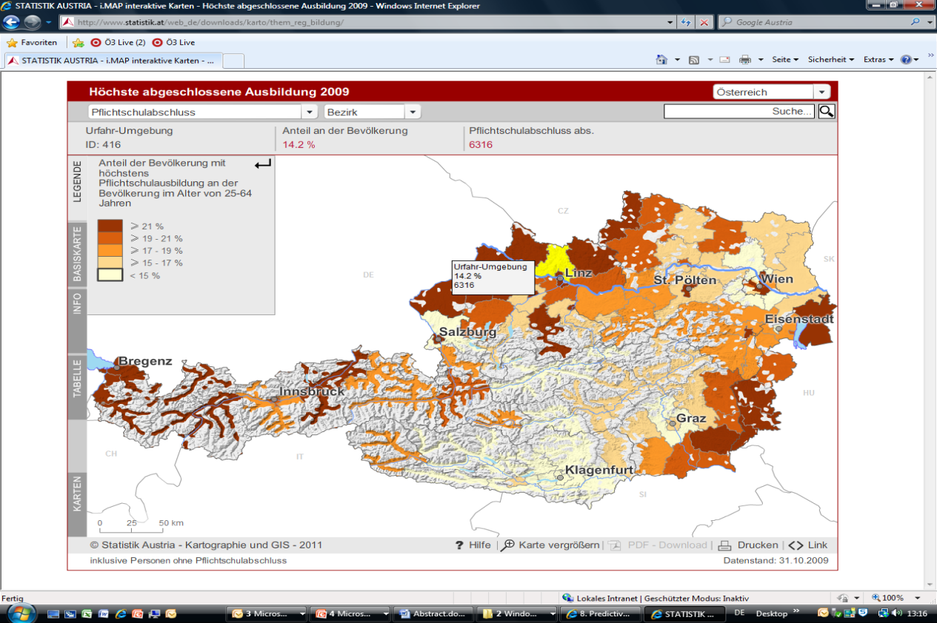
Register-based Census in Austria
First register-based Census in Austria 2011
Full Census, no sampling
Census topics
Population Census, Housing Census, Census of enterprises and their local units of employment
Data availability
On municipality level
Geo-Codes
Statistical databases
Interactive maps

Slide 4
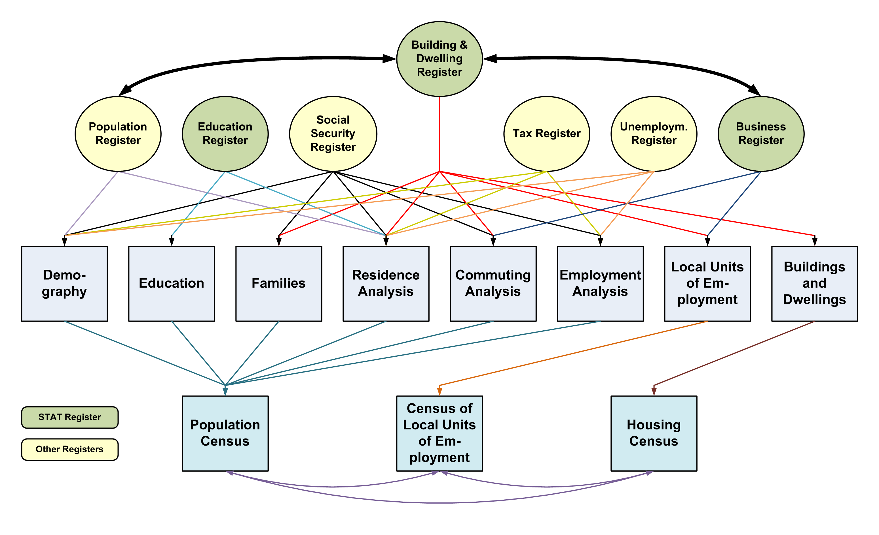
Base Registers – The Principle of Redundancy

Slide 5
Comparison Registers
Family Allowance Register (FAR)
Central Register of Foreigners (CRF)
Registers of Public Servants of the Federal State and the Federal Provinces (RPS)
Register of Car Owners (COR)
Register of Social Welfare Recipients (SWR)
Conscription Register (CR)
Register of Alternative Civilian Service (ACSR)
About 50 data-holders

Slide 6
The principle of redundancy
Same attribute in more than one register
Comparison registers are used to confirm the values in the base registers due to quality improvement
PIN | SEX_CPR | SEX_CSSR | SEX_TR | SEX_UR | SEX_VALID | RULE
… | … | … | … | … | … | …
2 | 1 | 1 | 1 | 0 | 1 | 1
3 | 1 | 0 | 0 | 0 | 1 | 2
4 | 0 | 2 | 0 | 2 | 2 | 3
5 | 2 | 2 | 1 | 1 | 2 | 4
… | … | … | … | … | … | …
CPR=Central Population Register, CSSR=Central Social Security Register, TR=Tax Register, UR=Unemployment Register

Slide 7
Matching of register data
By „branch-specific personal identification number official statistics“ (bPIN_OS)
Produced by the data protection office due to name, date of birth, and other personal information via CPR (central population register)
Registrar has to order these PINs in an encrypted form, which have to be transmitted to Statistics Austria (PINs + data)
Statistics Austria decrypts the bPIN_OS and uses this key as a common matching variable

Slide 8
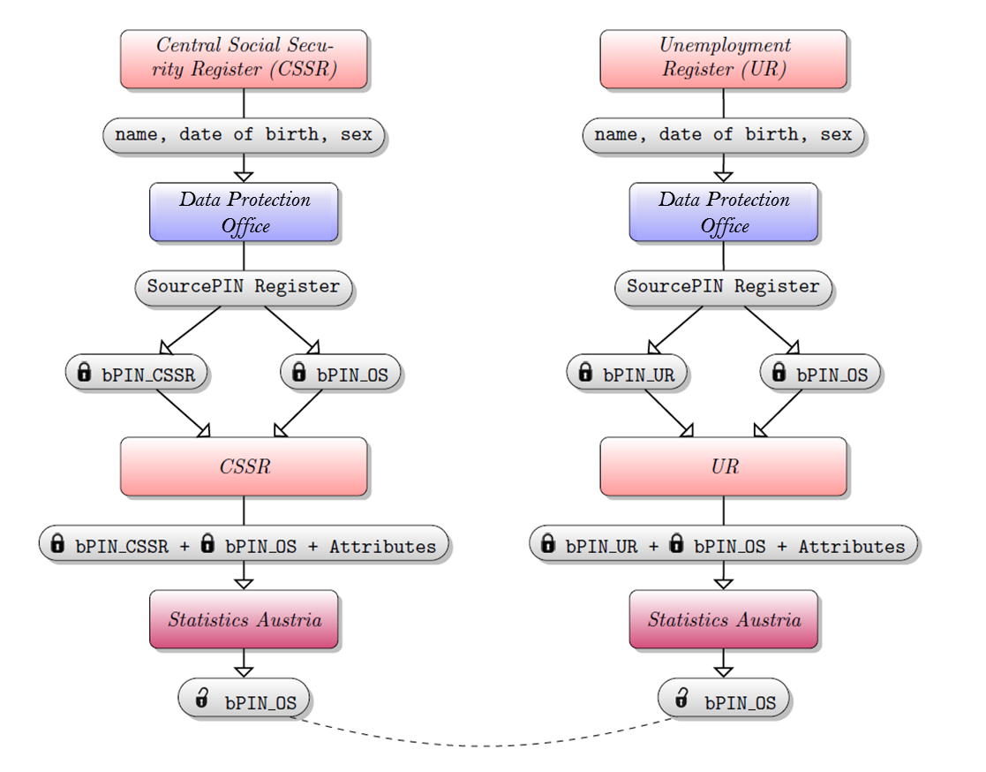
Data Privacy Protection – Unique keys

Slide 9
Data Privacy Protection – Target Record Swapping (1)
Requirements
Preservation of additivity and consistency of tables
Method should be universally applicable
Acceptance from users
Possibility of special analyses
→ Target Record Swapping

Slide 10
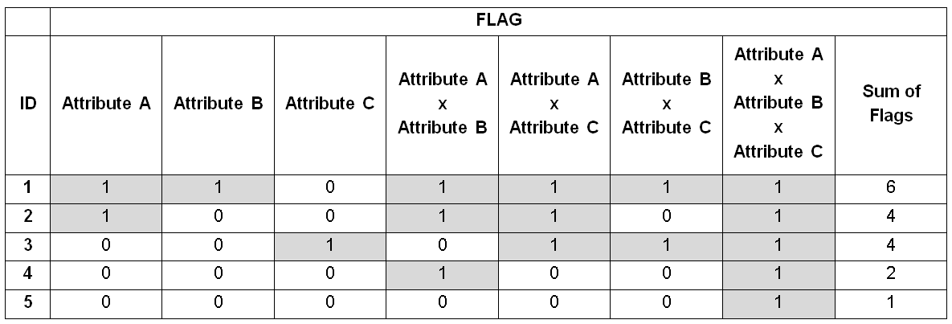
Data Privacy Protection – Target Record Swapping (2)
Detect risky records that could be identified because of their specific combination of attributes

Slide 11

Data Privacy Protection – Target Record Swapping (3)
Exchange single attributes of those records with the characteristics of another individual.
Educational Attainment
Educational Attainment

Slide 12
Analysis of Residence - Introduction
Who is counted?
Persons with a legal residence according to the Central Population Register (“main residence”) and
Must have lived in Austria for at least three months around census day (90-days) and
Must be confirmed by a process called Analysis of Residence
(Register-based Census Act)
Why is this procedure part of the Census?
To minimize overcoverage
Number of usual resident population is of vital importance for distribution of tax revenues from the federal state to the local authorities

Slide 13
Analysis of Residence – Signs of Life Analysis
Method of Residence Analysis
Send letters of clarification to the doubtable main residences
Ask the municipalities to prove the cases
PIN | CPR | CSSR | TR | UR | SWR | FAR
… | … | … | … | … | … | …
2 | ✓ | ✓ | ✓ | ✗ | ✗ | ✗
3 | ✓ | ✓ | ✗ | ✓ | ✗ | ✗
4 | ✓ | ✗ | ✗ | ✗ | ✗ | ✗
5 | ✓ | ✗ | ✗ | ✗ | ✓ | ✗
… | … | … | … | … | … | …
CPR=Central Population Register, CSSR=Central Social Security Register, TR=Tax Register, UR=Unemployment Register, SWR=Register of Social Welfare Recipients, FAR=Family Allowance Register
Single Entry

Slide 14
Analysis of Residence – Quality Assurance
Persons only found in CPR (single entries) are subject to queries (via an official letter): They are asked if they have been living in Austria on census day or not.
Re-identification for this persons via data protection office
Person is counted if he/she confirms his/her residence in Austria by mailing back the filled in and signed form.

Slide 15
Analysis of Residence – Quality Assurance
If the residence is not confirmed (either by the respondent or by the letter returning with a notice that the person does not live at this address), the person is a candidate for deletion.
But:
All recommended deletions are supplied to the local authorities. They have the right to oppose but must prove that the person still has his/her main residence in the municipality.
Other procedures to avoid overcoverage:
Checking for double counts (KIT–case)
Checking for deaths (DIED) → using CSSR data

Slide 16
Analysis of Residence
Retrospective correction to the CPR-entries:
To avoid undercoverage due to time lags we use CPR data extracted 6 months after census day:
Births usually are registered with a time lag of some days.
Registration in the new municipality within three days when moving.
Persons not registered on census day but in the CPR before and after census day are counted if the time gap < 90 days.
To avoid “Census tourism” – 180 days rule:
Registration – municipality A
Reference date: registration municipality B
Migrate back to municipality A within 180 days of the first migration
Counted in municipality A

Slide 17
Population Number 31 October 2011
in total 70 481 (0,83%)
fewer main residences counted
0,74%
of the persons
were deleted because of the residence analysis
-70 481 + 3 115 = -67 326
(- not counted + retrosp. corr.)

Slide 18
Differences: Census and RBLMS
Analysis of Residence: just at Census (2011, 2021,…)
Annually Register-based labour market Statistics (RBLMS):
Persons who are only recorded in the CPR (single entry) = clarification cases and doubtable main residences
Clarification cases are divided in counted cases and deleted cases
Decision whether case is counted or deleted is based on a formula (logistic regression model)
Annually quality evaluation (Sources + Output)

Slide 19
Quality assessment of register based Statistics Introduction
Aim
To evaluate the data quality of the register-based statistics for each attribute
Calculation of quality indicators
Quality indicators are derived for each attribute in each register
Further these indicators are calculated for the different levels of data processing
Standardization of the indicators
The range of each indicator is between 0 and 1. This makes the results comparable, both between registers and over time
Independence of the quality framework
The framework is closely tied to the data flow, but independent from data processing

Slide 20
Quality assessment of register based Statistics
How can we ensure the quality of the information that we get from the data holders?
Three stages of quality evaluation
Raw data
Registers provided by the data holders
Central Database (CDB)
Combined information from the registers
Data is merged by a unique key
Final Data Pool (FDP)
Final data including imputations
RAW
CDB
FDP

Slide 21
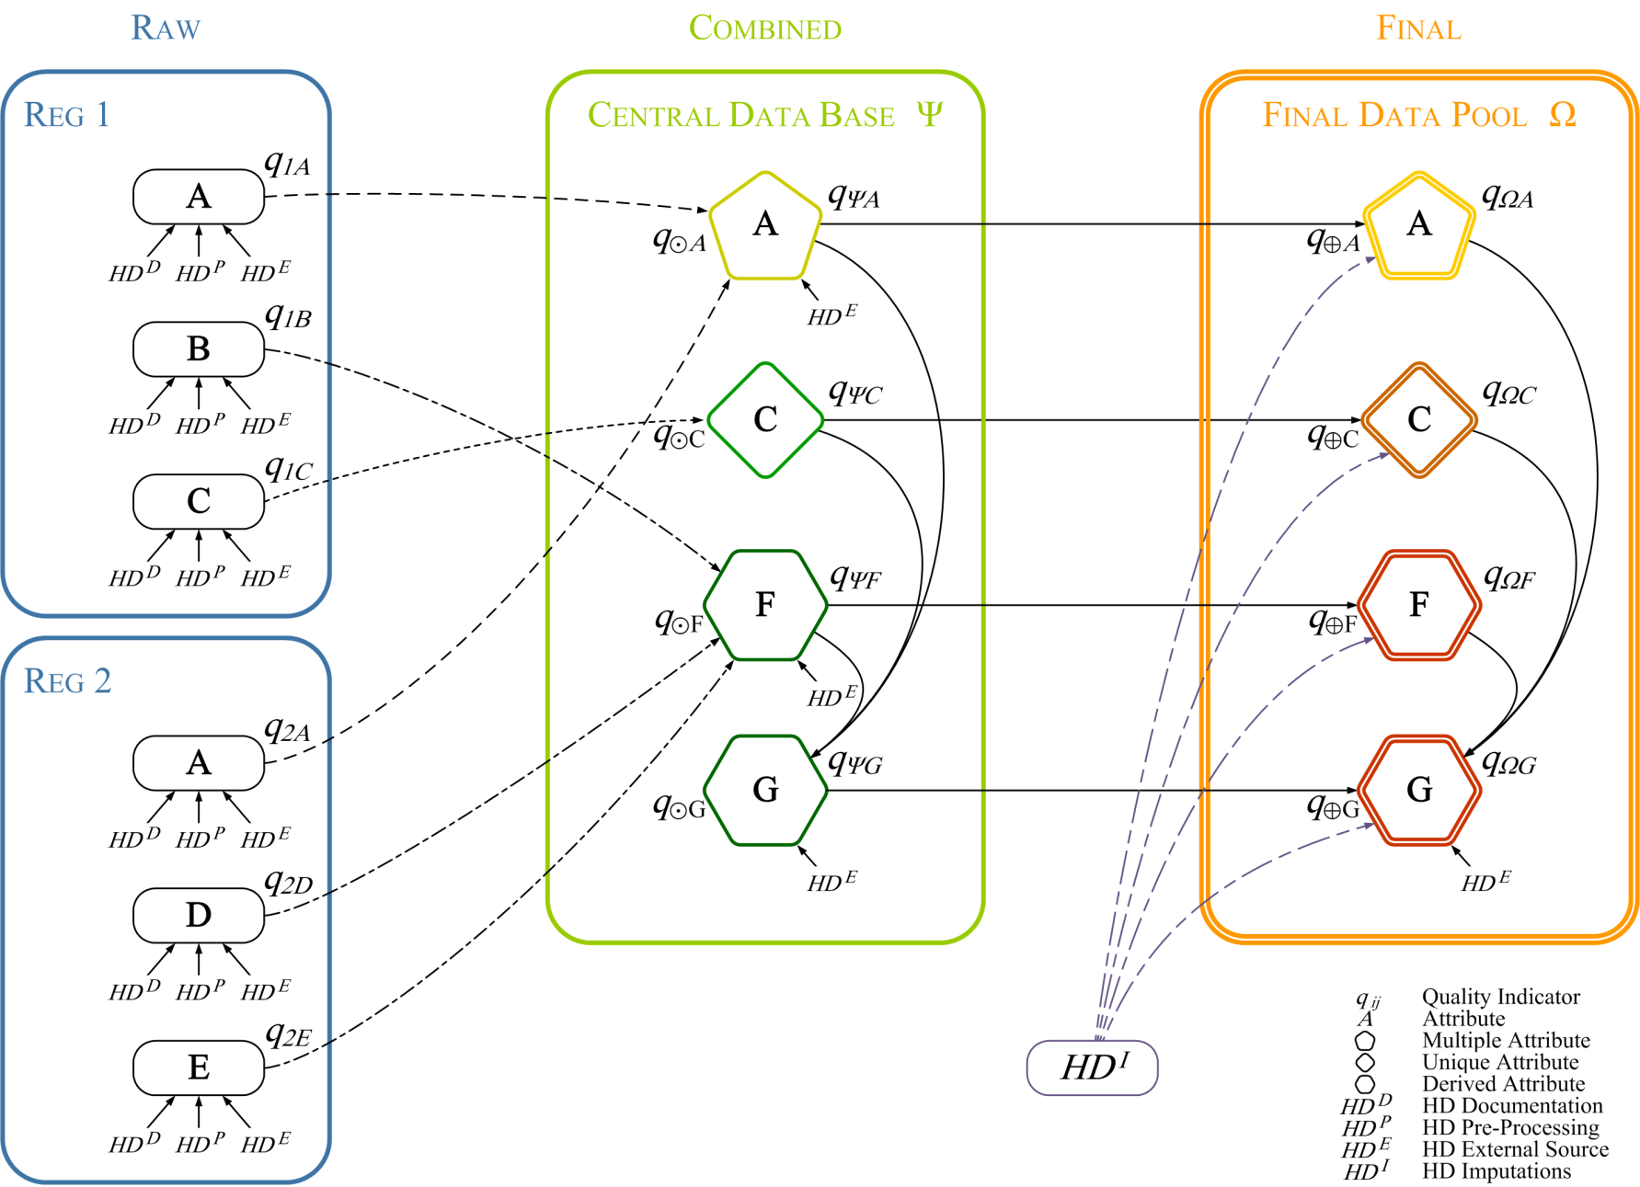
Quality framework

Slide 22
Quality framework – register level

Slide 23
Hyperdimensions on register level
Hyperdimension Documentation (HD^{D}) Quality of data generation and documentation
Hyperdimension Pre-processing (HD^{P}) Detection of formal errors, missing primary keys and non-response
Hyperdimension External Source (HDE) Comparison of data to an external source
Hyperdimension Imputation (HD^{I}) Quality assessment of the imputations

Slide 24
Quality assessment on register level I
Calculation of quality indicators
Each attribute in each register gets a quality between 0 and 1
Quality calculation is based on 3 hyperdimensions
HD Documentation
Focuses on factors which possibly predetermine data quality
Realized by a questionnaire which is filled out in accordance with the data authority
Questions are weighted by their impact on data quality
Quality indicator:
obtained score
maximum obtainable score

Slide 25
Results of register-quality: AGE (RBLMS 2015)
HD-Subdimension | RPS | FAR | CSSR | CRF | CH | HPS | SWR | TR | ACSR | CPR | CCSR
Detect Changes
Cut-off date
Definitions | 1.00 | 1.00 | 1.00 | 1.00 | 1.00 | 1.00 | 1.00 | 1.00 | 1.00 | 1.00 | 1.00
Relevance | 0.89 | 1.00 | 1.00 | 1.00 | 1.00 | 1.00 | 1.00 | 0.00 | 1.00 | 1.00 | 1.00
Legal basis | 1.00 | 1.00 | 1.00 | 1.00 | 0.60 | 0.60 | 1.00 | 1.00 | 1.00 | 1.00 | 1.00
Timeliness | 1.00 | 1.00 | 1.00 | 1.00 | 1.00 | 0.90 | 1.00 | 1.00 | 0.50 | 1.00 | 1.00
Administrative Contr | 0.89 | 1.00 | 1.00 | 0.67 | 0.80 | 0.87 | 0.95 | 0.00 | 1.00 | 1.00 | 1.00
Technical Contr | 0.93 | 1.00 | 1.00 | 0.67 | 0.80 | 0.60 | 0.95 | 0.00 | 1.00 | 1.00 | 1.00
Data management | 0.85 | 0.67 | 1.00 | 0.33 | 0.87 | 0.67 | 0.69 | 0.00 | 1.00 | 1.00 | 1.00
HDD | 0.92 | 0.93 | 1.00 | 0.78 | 0.90 | 0.83 | 0.92 | 0.33 | 0.92 | 1.00 | 1.00
RPS … Registers of Public Servants of the Federal State and the Federal Provinces
FAR … Family Allowance Register
CSSR …Central social security Register
CRF … Central Register of Foreigners
CH … Chambers Register
HPS … Health insurance of Public Servants
SWR …Register of Social Welfare Recipients
TR … Tax Register
ACSR …Register of Alternative Civilian Service
CPR … Central Population Register
CCSR …Central Civil Status Register

Slide 26
Quality assessment on register level II
HD Pre-processing
Detection of formal errors, like missing primary keys, out-of-range values and item non-response
Usable records are calculated by the subtraction of erroneous records from total records
Quality indicator:
HD External Source
The accuracy of the data is checked (at all stages if necessary)
Comparison with existing representative surveys
Quality indicator:
usable records
total number of records
number of consistent values
total number of linked records

Slide 27
Results of register-Quality: AGE (RBLMS 2015)
 | RPS | FAR | CSSR | CRF | CH | HPS | SWR | TR | ACSR | CPR | CCSR
Pre-Processing
Observations (thou.) | 674 | 3,813 | 9,328 | 3,483 | 22 | 94 | 285 | 10,109 | 11 | 9,914 | 519
Missing PIN % | 1.28 | 4.84 | 5.24 | 38.70 | 1.95 | 0.74 | 1.03 | 8.56 | 4.03 | 0.00 | 0.00
Non resp. & Out of range % | 0.00 | 0.14 | 0.14 | 0.00 | 0.00 | 0.01 | 0.02 | 16.12 | 0.00 | 0.01 | 0.00
HDP | 0.99 | 0.95 | 0.95 | 0.61 | 0.98 | 0.99 | 0.99 | 0.75 | 0.96 | 1.00 | 1.00
External source
Linked observations | 5,020 | 28,357 | 66,143 | 5,999 | 166 | 515 | 1,309 | 39,207 | 91 | 67,636 | 1,937
Conflicting observations % | 0.24 | 0.18 | 0.20 | 0.68 | 0.00 | 0.00 | 0.46 | 0.22 | 0.00 | 0.19 | 0.46
HDE | 1.00 | 1.00 | 1.00 | 0.99 | 1.00 | 1.00 | 1.00 | 1.00 | 1.00 | 1.00 | 1.00
RPS … Registers of Public Servants of the Federal State and the Federal Provinces
FAR … Family Allowance Register
CSSR …Central social security Register
CRF … Central Register of Foreigners
CH … Chambers Register
HPS … Health insurance of Public Servants
SWR …Register of Social Welfare Recipients
TR … Tax Register
ACSR …Register of Alternative Civilian Service
CPR … Central Population Register
CCSR …Central Civil Status Register

Slide 28
Register level – quality indicators
Overview: quality indicators of the three hyperdimensions
Documentation: HD^{D} =
Pre-processing: HD^{P} =
External source: HDE =
The overall quality indicator for each attribute in each register is a weighted sum of the three quality indicators.
obtained score
maximal obtainable score
usable records
total number of records
consistent values
total number of linked records
v^{D}*HD^{D}_{ij}
v^{P}*HD^{P}_{ij}
q_{ij}
v^{E}*HDE_{ij}

Slide 29
Quality indicators on register level (AGE, RBLMS 2015)
 | RPS | FAR | CSSR | CRF | CH | HPS | SWR | TR | ACSR | CPR | CCSR
HDD | 0.92 | 0.93 | 1.00 | 0.78 | 0.90 | 0.83 | 0.92 | 0.33 | 0.92 | 1.00 | 1.00
HDP | 0.99 | 0.95 | 0.95 | 0.61 | 0.98 | 0.99 | 0.99 | 0.75 | 0.96 | 1.00 | 1.00
HDE | 1.00 | 1.00 | 1.00 | 0.99 | 1.00 | 1.00 | 1.00 | 1.00 | 1.00 | 1.00 | 1.00
q_{ij} | 0.97 | 0.96 | 0.98 | 0.79 | 0.96 | 0.94 | 0.97 | 0.69 | 0.96 | 1.00 | 1.00
RPS … Registers of Public Servants of the Federal State and the Federal Provinces
FAR … Family Allowance Register
CSSR …Central social security Register
CRF … Central Register of Foreigners
CH … Chambers Register
HPS … Health insurance of Public Servants
SWR …Register of Social Welfare Recipients
TR … Tax Register
ACSR …Register of Alternative Civilian Service
CPR … Central Population Register
CCSR …Central Civil Status Register

Slide 30
Quality framework – CDB level

Slide 31
Types of attributes on CDB level
Unique Attributes
Attribute exists in only one register, directly transferred to the CDB (e.g. highest level of education)
Multiple Attributes
Attribute exists in more than one register, combined in the CDB using certain decision rules (e.g. demographic attributes)
Derived Attributes
Attribute is created based on other attributes (e.g. type of commuter)
SEX_Reg1
SEX_Reg2
SEX_Reg3
Multiple Attribute
Attrib1
Attrib2
Derived Attribute

Slide 32
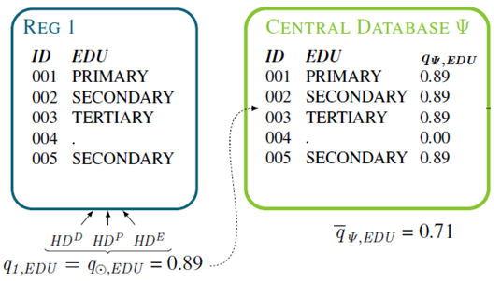
Unique attributes - CDB level
The highest level of education (EDU) is delivered by one single register. The quality indicator is derived by the three hyperdimensions.
There are still missing values (with quality=0) that decrease the quality indicator in the CDB.

Slide 33
Multiple attributes – CDB level (1)
Application of Dempster-Shafer Theory
Degree of belief is taken into account
Quality is calculated regarding consistent & conflicting values
Consistency with other sources: q_{CDB} ↑
Conflict with other sources: q_{CDB} ↓
SEX: q_{REG1, SEX} = 0.9 q_{REG2, SEX} = 0.7
PIN | REG 1 | REG 2 | CDB | q_{CDB}
1 | male | male | male | 0.97 (= 0.9*0.7 + 0.9*(1-0.7) +(1-0.9)*0.7)
2 | male | female | male | 0.73 (=0.9*(1-0.7)/(1-0.9*0.7))
3 | female | male | female | 0.73 (=0.9*(1-0.7)/(1-0.9*0.7))

Slide 34
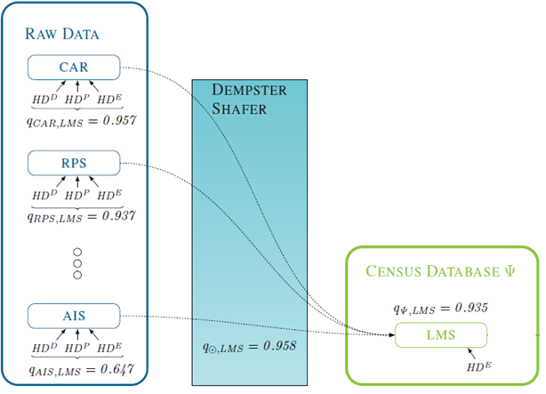
Multiple attributes – CDB level (2)
The attribute is available in seven registers. The quality indicators are derived by the three hyperdimensions for each register.
FAR
RPS
-
CRF
-
The Dempster-Shafer theory allows to combine all the available information for an attribute from the spending-registers
There are still missing values (with quality=0) that decrease the quality indicator in the CDB.

Slide 35
Derived attributes – CDB level (1)
Derived attribute: Attribute is created based on other attributes, e.g. Current activity Status (CAS):
PIN | REG 1
1 | employed; white-collar worker
1 | maternity leave
2 | orphan´s pension
3 | employed; blue-collar worker
PIN | CDB
1 | currently economically active (employed; white-collar worker)
2 | currently not economically active (school pupil)
3 | currently economically active (employed; blue-collar worker)
4 | currently not economically active (university student)
PIN | REG 2
1 | college student
2 | school pupil
4 | university student

Slide 36
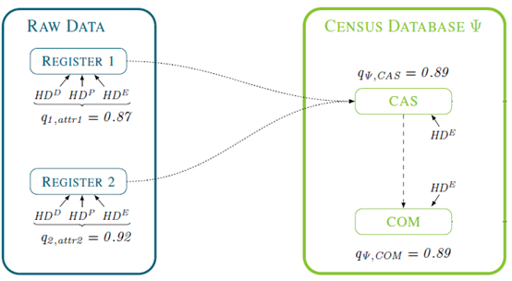
Derived attributes – CDB level (2)
There is no information on current activity status (CAS) or commuters (COM) in the raw data. We derive the information for CAS from two other attributes in two data sources.
We obtain the required information for COM from the already derived attribute CAS. Thus, the quality indicator of both attributes is equal.

Slide 37
Quality framework – FDP level

Slide 38
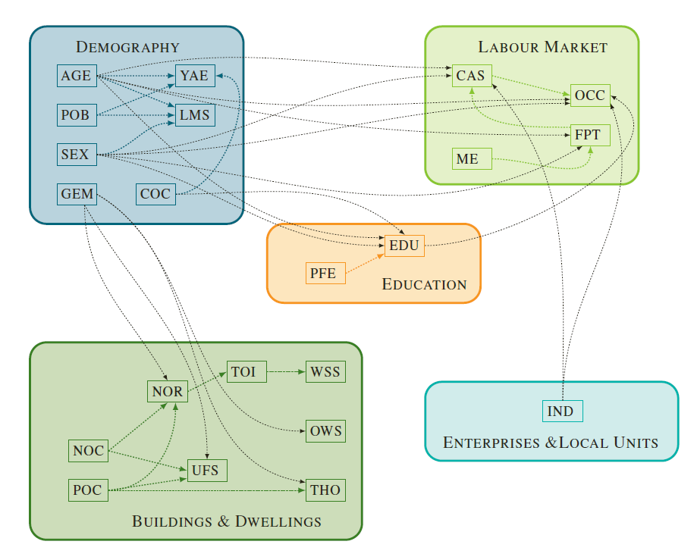
Imputation: Structured estimation order
Demographic attributes, like age and sex, are the first in the estimation order, variables concerning the labour market are the last.
The relationships between variables are not confined within the subjects, but also connect variables between the topics.

Slide 39
Hyperdimensions on FDP level
Hyperdimension Documentation (HD^{D}) Quality of data generation and documentation
Hyperdimension Pre-processing (HD^{P}) Detection of formal errors, missing primary keys and non- response
Hyperdimension External Source (HDE) Comparison of data to an external source
Hyperdimension Imputation (HD^{I}) Quality assessment of the imputations

Slide 40
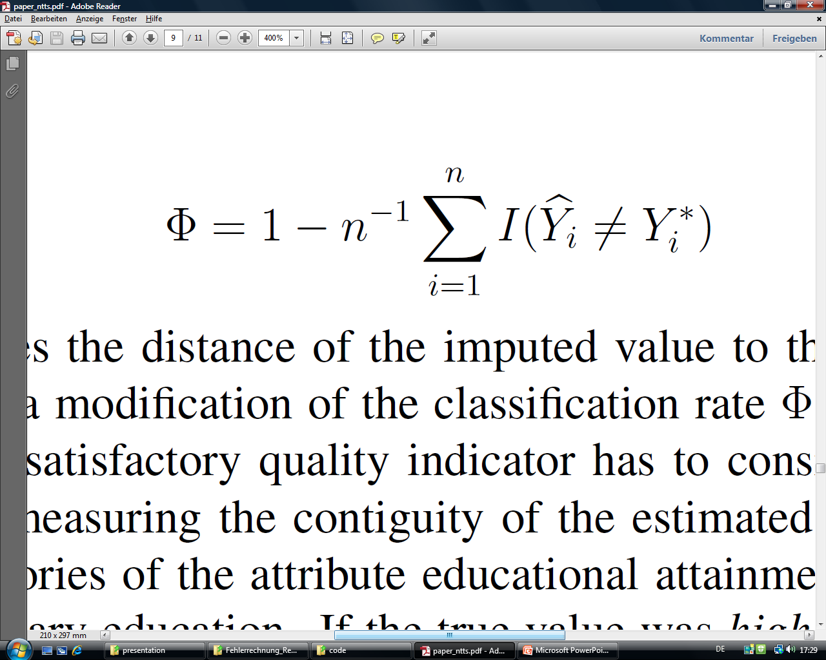
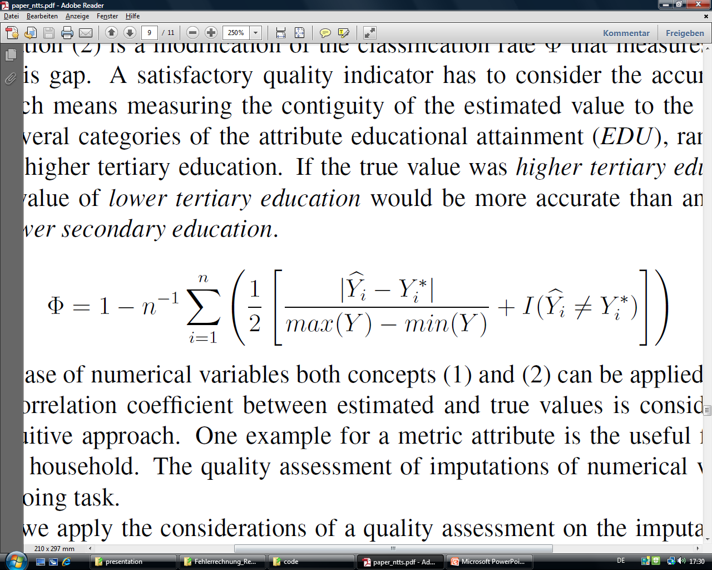
Assessment of imputation methods
Classification rate measures the „hit ratio“
The imputation model is applied on already existing data
How many estimated values match with the true data?
Classification rate for categorical variables
Classification rate for ordinal variables
The distances between estimated and true values matter

Slide 41
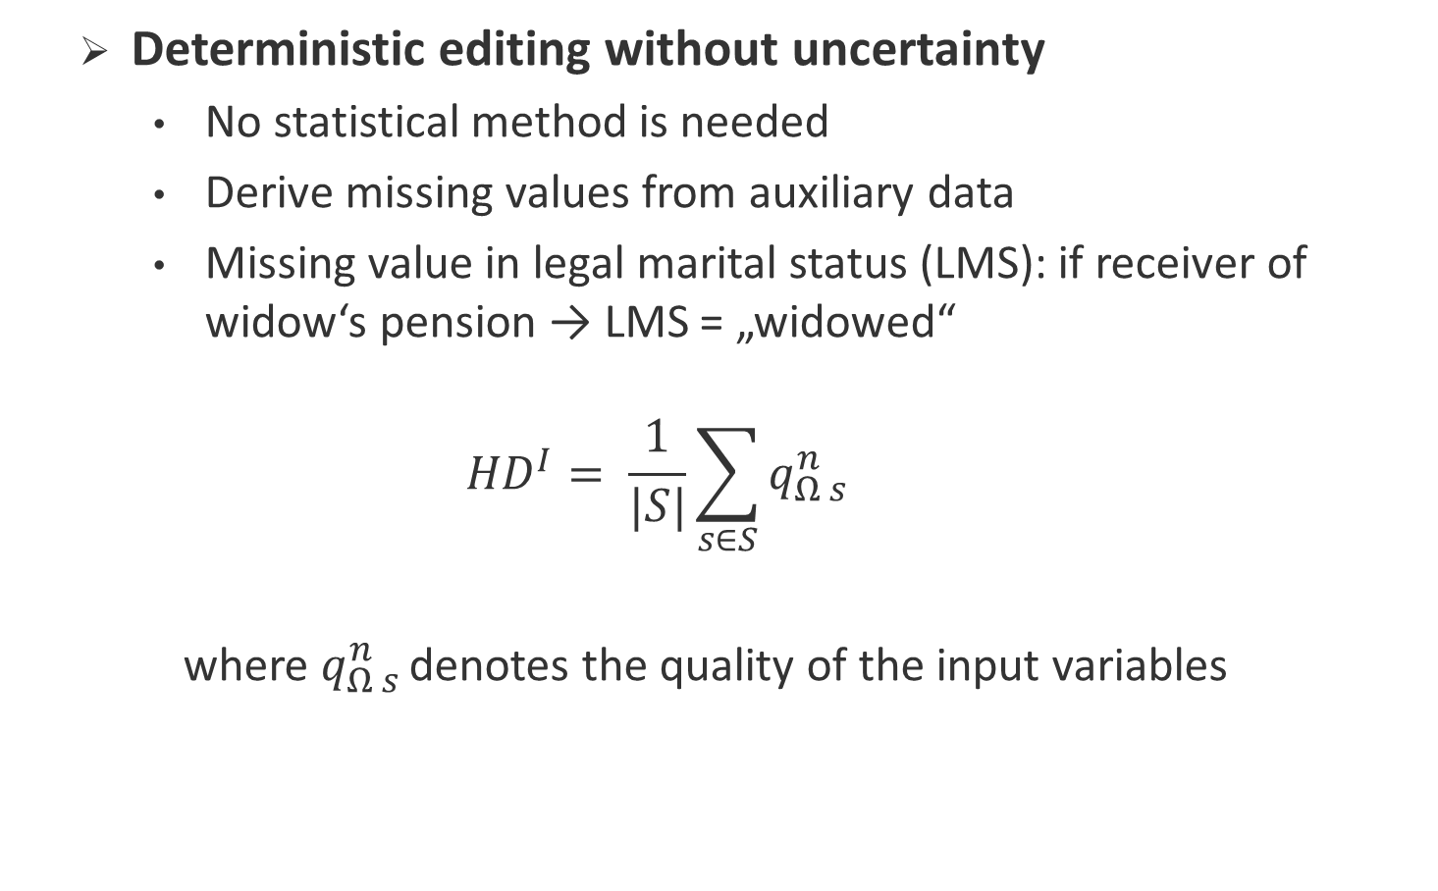
Imputation methods I
Deterministic editing without uncertainty
No statistical method is needed
Derive missing values from auxiliary data
Missing value in legal marital status (LMS): if receiver of widow‘s pension → LMS = „widowed“
$${HD}^{I}= \frac{1}{|S|}\sum_{s∈S}{q_{Ω s }^{n}}$$
where $q_{Ω s }^{n}$denotes the quality of the input variables

Slide 42
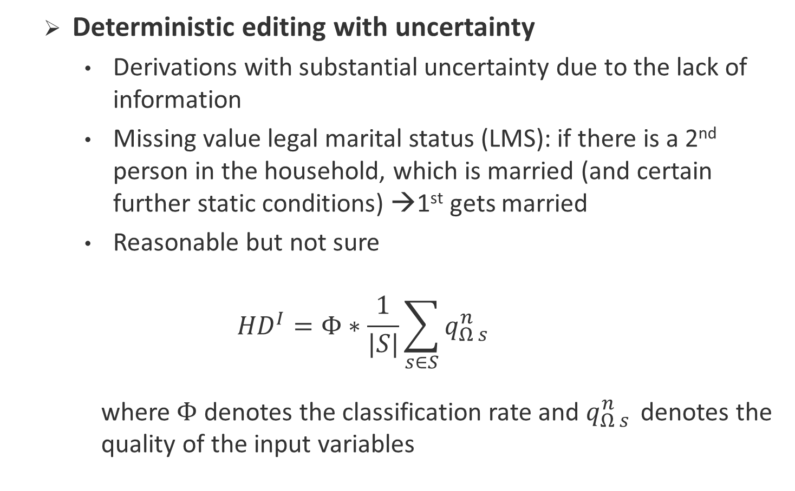
Imputation methods II
Deterministic editing with uncertainty
Derivations with substantial uncertainty due to the lack of information
Missing value legal marital status (LMS): if there is a 2nd person in the household, which is married (and certain further static conditions) →1st gets married
Reasonable but not sure
$${HD}^{I}=Φ∗\frac{1}{|S|}\sum_{s∈S}{q_{Ω s }^{n}}$$
where$Φ$ denotes the classification rate and $q_{Ω s }^{n}$ denotes the quality of the input variables

Slide 43
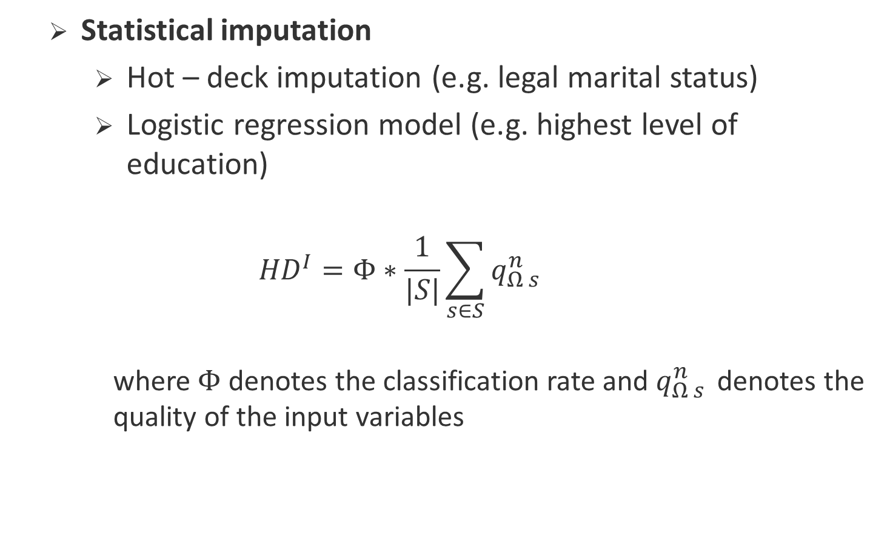
Imputation methods III
Statistical imputation
Hot – deck imputation (e.g. legal marital status)
Logistic regression model (e.g. highest level of education)
$${HD}^{I}=Φ∗\frac{1}{|S|}\sum_{s∈S}{q_{Ω s }^{n}}$$
where$Φ$ denotes the classification rate and $q_{Ω s }^{n}$ denotes the quality of the input variables

Slide 44
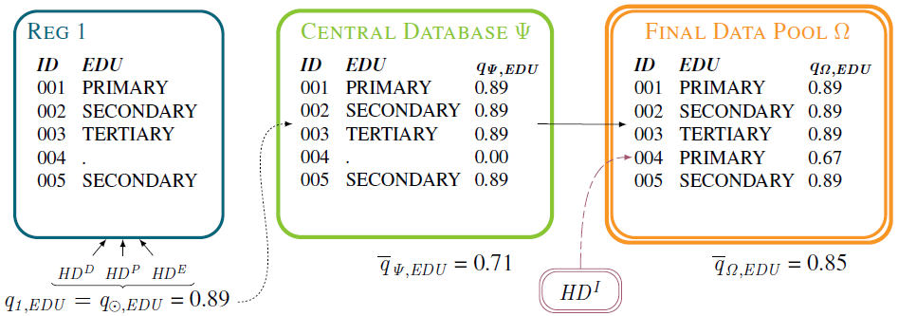
Quality assessment on FDP level
The educational attainment (EDU) is delivered by one single register. The quality indicator is derived by three hyperdimensions.
There are still missing values (with quality=0) that decrease the quality indicator in the CDB.
After imputations of missing values, we assess the quality indicator of the attribute EDU in the Final Data Pool.

Slide 45
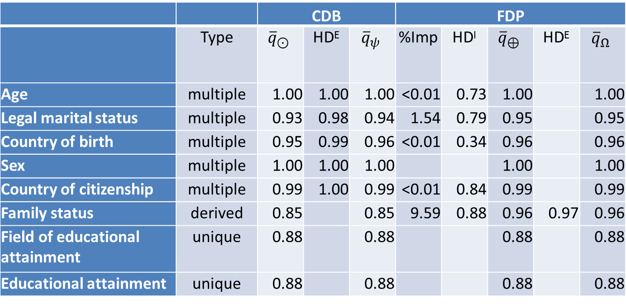
Results of the RBLMS 2015
 |  | CDB |  |  | FDP
 | Type | $${\overline{q}}_{⊙}$$ | HDE | $${\overline{q}}_{ψ}$$ | %Imp | HD^{I} | $${\overline{q}}_{⊕}$$ | HDE | $${\overline{q}}_{Ω}$$
Age | multiple | 1.00 | 1.00 | 1.00 | <0.01 | 0.73 | 1.00 |  | 1.00
Legal marital status | multiple | 0.93 | 0.98 | 0.94 | 1.54 | 0.79 | 0.95 |  | 0.95
Country of birth | multiple | 0.95 | 0.99 | 0.96 | <0.01 | 0.34 | 0.96 |  | 0.96
Sex | multiple | 1.00 | 1.00 | 1.00 |  |  | 1.00 |  | 1.00
Country of citizenship | multiple | 0.99 | 1.00 | 0.99 | <0.01 | 0.84 | 0.99 |  | 0.99
Family status | derived | 0.85 |  | 0.85 | 9.59 | 0.88 | 0.96 | 0.97 | 0.96
Field of educational attainment | unique | 0.88 |  | 0.88 |  |  | 0.88 |  | 0.88
Educational attainment | unique | 0.88 |  | 0.88 |  |  | 0.88 |  | 0.88

Slide 46
Usability of the quality indicators
Raw data
Which register delivers a certain attribute with the highest quality indicator?
Is there a register with a below-average quality for all delivered attributes?
Is the quality indicator of a certain attribute worse than in the last delivery?
Results of the hyperdimensions on this level for quality reports and information to data owners on aggregated level (quality indicator on register level)
Central Database
Is there any advancement of data quality by the use of multiple data sources?
Comparison with prior data on this stage – plausibility checks
Final Data Pool
Quality reports
Comparison of attributes for further advancement
Comparison of results over time
RAW
CDB
FDP
Notes:
If indicator is unchanged – nothing to do, otherwise further investigations

Slide 47
Potentials and perspectives
Quality indicators on register level
- each attribute in each register is associated with a quality indicator
- indicators can also be used for other projects and deliver
essential information about the quality
Quality indicators for the Final Data Pool of register-based statistics
- indicator for each attribute which covers all quality-related aspects
quality of the register
quality of imputations
- The experience gained with the new census type can be of use for
other population and household surveys
- The quality framework can be used for other register-based statistics

Slide 48
Further Information
Austrian Journal of Statistics, Vol. 39 (2010), No. 4
http://www.stat.tugraz.at/AJS/ausg104/104Berka.pdf
Statistica Neerlandica, Volume 66 (2012), Issue 1
Journal of Official Statistics, Vol. 31, No. 2
http://dx.doi.org/10.1515/JOS-2015-0015
Austrian Journal of Statistics Vol. 45, No. 2 https://www.ajs.or.at/index.php/ajs/article/view/vol45-2-1/273
Documentation of Methods http://www.statistik.at/web_de/static/documentation_of_methods_077211.pdf
Q2016 http://www.ine.es/q2016/docs/q2016Final00021.pdf
Q2018 https://www.q2018.pl/wp-content/uploads/Sessions/Session%2011/Johannes%20Gussenbauer/Session%2011_Johannes%20Gussenbauer.docx
ESSNet Komuso (forthcoming) https://ec.europa.eu/eurostat/cros/content/essnet-quality-multisource-statistics-komuso_en
Notes:
aktualisieren

Slide 49
Please address queries to:
Manuela Lenk
Contact information:
Guglgasse 13, 1110 Vienna
phone: +43 (1) 71128-8283
fax: +43 (1) 71128-7445
manuela.lenk@statistik.gv.at
Quality assessment of register based statistics
Workshop on Survey Statistics 2018

